Slide 1

Swing API
CCS0023/L
Object Oriented Programming (Java)

Slide 2
13
LESSON #13
Swing API
Swing API

Slide 3
SWING APPLICATION PROGRAMMING INTERFACE (API)
Java Swing tutorial is a part of Java Foundation Classes (JFC) that is used to create window-based applications. It is built on the top of AWT (Abstract Windowing Toolkit) API and entirely written in java.
Unlike AWT, Java Swing provides platform-independent and lightweight components.
The javax.swing package provides classes for java swing API such as JButton, JTextField, JTextArea, JRadioButton, JCheckbox, JMenu, JColorChooser etc.
Swing API

Slide 4
What is JFC
The Java Foundation Classes (JFC) are a set of GUI components which simplify the development of desktop applications.
Swing API

Slide 5
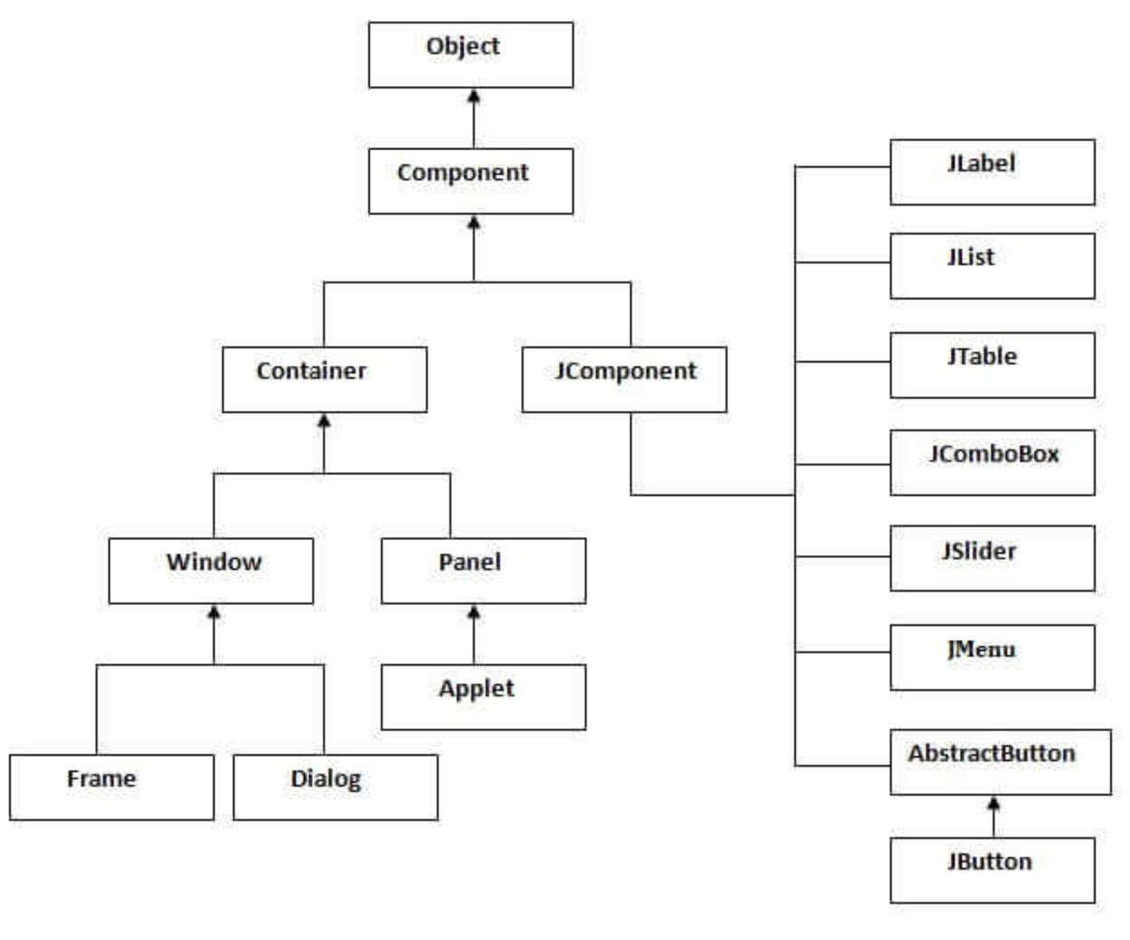
Hierarchy of Java Swing Classes
Swing API

Slide 6
JOptionPane
Provides prebuilt dialog boxes for both input and output.
Under package javax.swing
Swing API

Slide 7
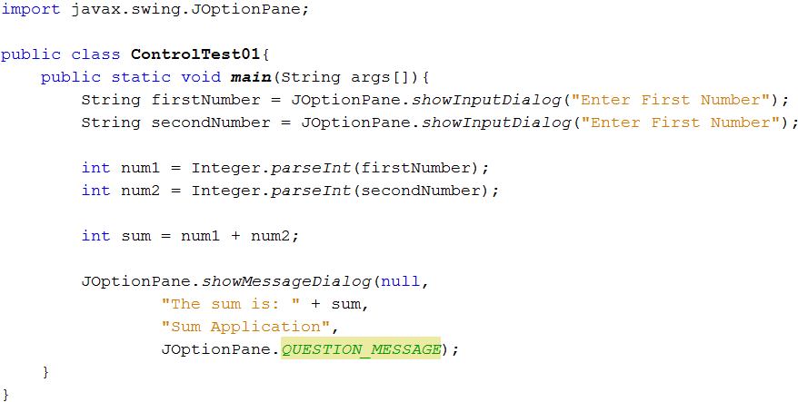
JOptionPane Class Example Program
Swing API

Slide 8


JOptionPane Message Dialog Constants
Message dialog type | Icon | Description
ERROR_MESSAGE |  | Indicates an error to the user
INFORMATION_MESSAGE |  | Indicates an informal message to the user
WARNING_MESSAGE |  | Warns the user of a potential problem
QUESTION_MESSAGE |  | Poses a question to the user. This dialog normally requires a response, such as clicking a Yes or a No button
PLAIN_MESSAGE | No icon | A dialog that contains a message, but no icon
Swing API

Slide 9
Swing GUI Components
From package javax.swing
Used to build Java GUIs
Part of the Java Foundation Classes (JFC)
Java libraries for cross platform GUI development
Allow you to specify a uniform look-and-feel for your application across all platforms or to use each platform’s custom look-and-feel.
Swing API

Slide 10
Basic GUI Components
Component | Description
JLabel | Display uneditable text or icons
JTextField | Enables user to enter data from the keyboard. Can also be used to display editable or uneditable text.
JButton | Triggers an event when clicked with the mouse button.
JCheckBox | Specifies an option that can be selected or not selected.
JComboBox | Provides a drop-down list of items from which the user can make a selection by clicking an item or possibly by typing into the box.
JList | Provides a list of items from which the user can make a selection by clicking on any item in the list. Multiple elements can be selected.
JPanel | Provides an area in which components can be placed and organized. Can also be used as a drawing area for graphics.
Swing API

Slide 11
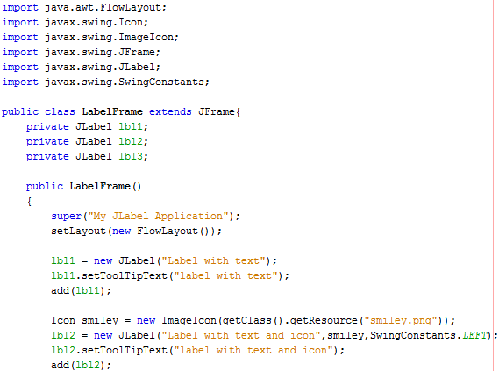
JLabel
Swing API

Slide 12
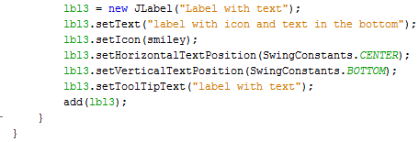
Basic GUI Components
Swing API

Slide 13
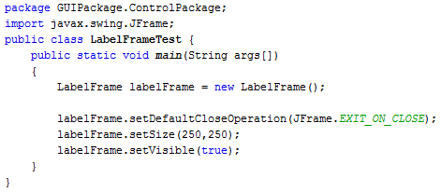
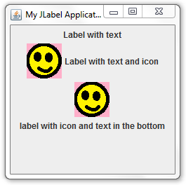
Basic GUI Components
Swing API

Slide 14
Positioning Constants
Constant | Description
SwingConstant.LEFT | Place text on the left
SwingConstant.CENTER | Place text in the center
SwingConstant.RIGHT | Place text on the right
SwingConstant.TOP | Place text at the top
SwingConstant.CENTER | Place text in the centers
SwingConstant.BOTTOM | Place text at the botton
Swing API

Slide 15
Text Fields and Introduction to Event Handling
GUIs are event driven
Event
Drives the program to perform a task (ex. Clicking a button, typing in a text field, selecting an item from a menu, closing a window and moving the mouse)
The code that performs a task in response to an event is called an event handler, and the overall process of responding to event is known as event handling.
Swing API

Slide 16
Set Up Event Handling Steps
Create a class that represents the event handler
Implement an appropriate interface (event-listener interface)
Register the event handling (registering the event handler)
Swing API

Slide 17
Some event classes of package java.awt.event
Object
ActionEvent
AdjustmentEvent
ContainerEvent
EventObject
ItemEvent
FocusEvent
AWTEvent
TextEvent
PaintEvent
ComponentEvent
WindowEvent
InputEvent
KeyEvent
MouseEvent
MouseWheelEvent
Swing API

Slide 18
Some event-listener interfaces of package java.awt.event
<<interface>>
java.util.EventListener
<<interface>>
ActionListener
<<interface>>
AdjustmentListener
<<interface>>
ComponentListener
<<interface>>
ContainerListener
<<interface>>
FocusListener
<<interface>>
ItemListener
<<interface>>
KeyListener
<<interface>>
MouseListener
<<interface>>
MouseMotionListener
<<interface>>
KeyListener
<<interface>>
WindowListener
Swing API

Slide 19
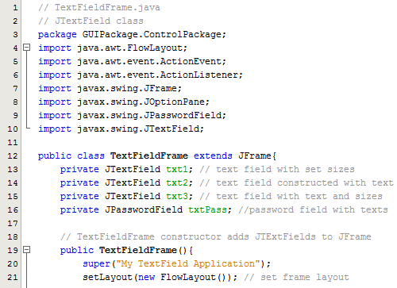
Text Fields and Introduction to Event Handling
Swing API

Slide 20
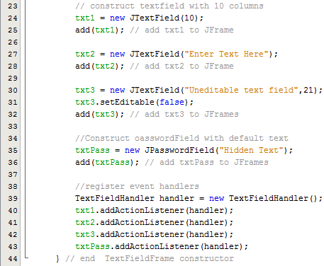
Text Fields and Introduction to Event Handling
Swing API

Slide 21
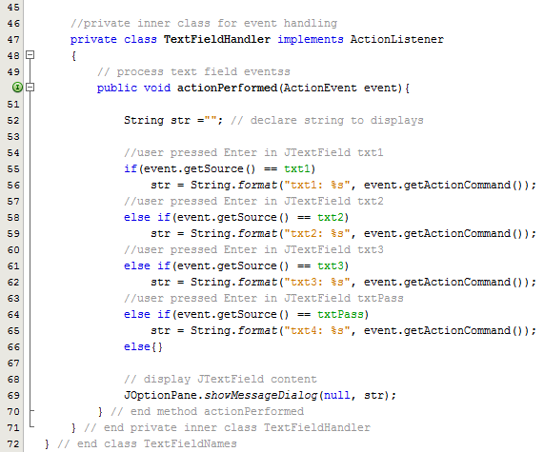
Text Fields and Introduction to Event Handling
Swing API

Slide 22
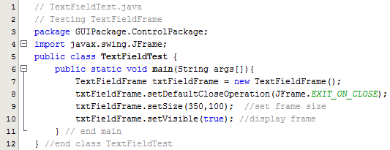
Text Fields and Introduction to Event Handling
Swing API

Slide 23
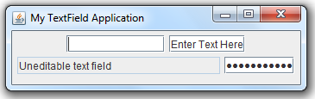
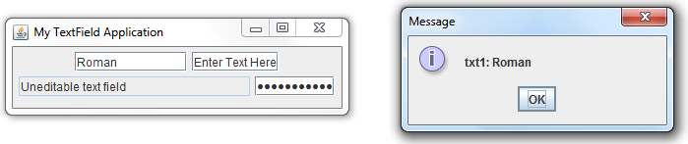
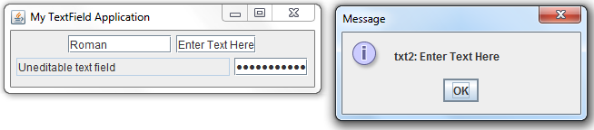
Text Fields and Introduction to Event Handling
Swing API

Slide 24
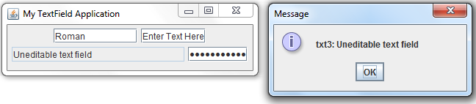
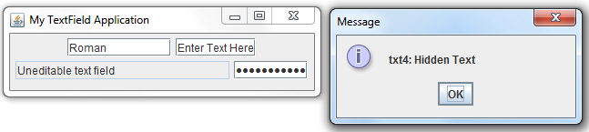
Text Fields and Introduction to Event Handling

Slide 25
JButton
Button – is a component the user clicks to trigger a specific action. (command buttons, checkboxes, toggle buttons and radio buttons)
Command button are created with class JButton
JComponent
AbstractButton
JButton
JToggleButton
JCheckBox
JRadioButton
Swing API

Slide 26
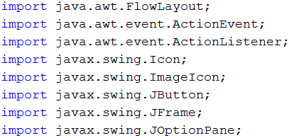
JButton
Swing API

Slide 27
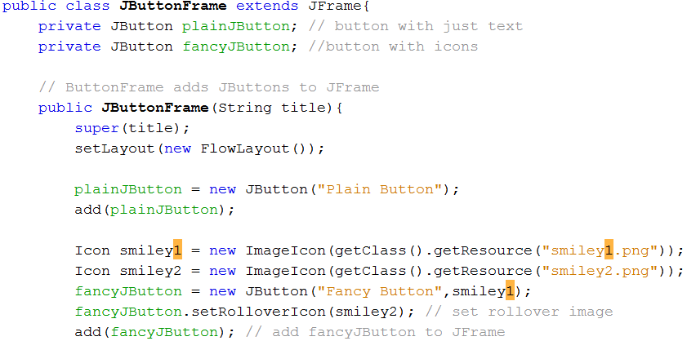
JButton
Swing API

Slide 28
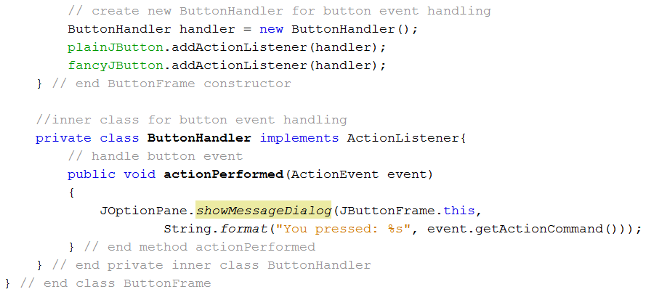
JButton
Swing API

Slide 29
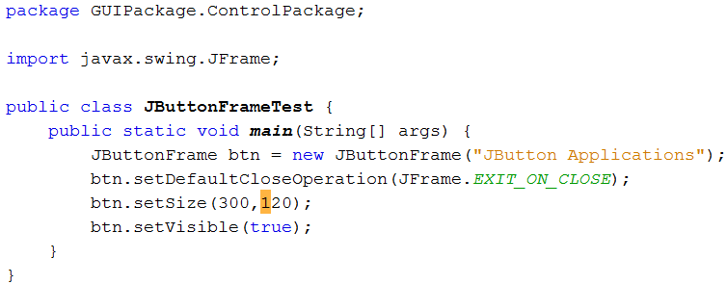
JButton
Swing API

Slide 30
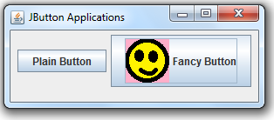
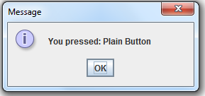
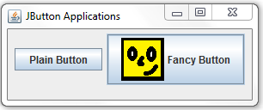
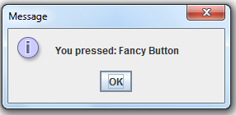
JButton
Swing API

Slide 31
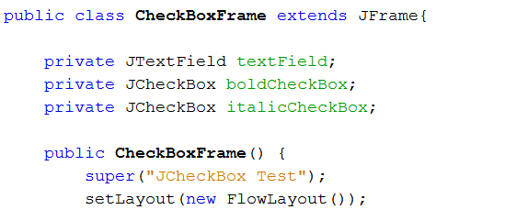
Buttons That Maintain State
1. JToggleButton
2. JCheckBox
3. JRadioButton
JCheckBox
Swing API

Slide 32
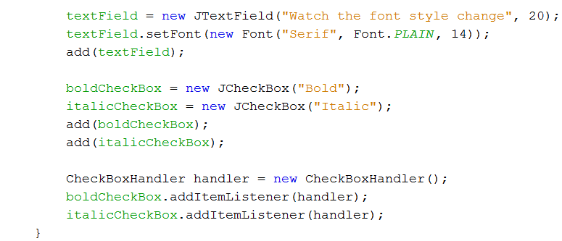
Swing API

Slide 33
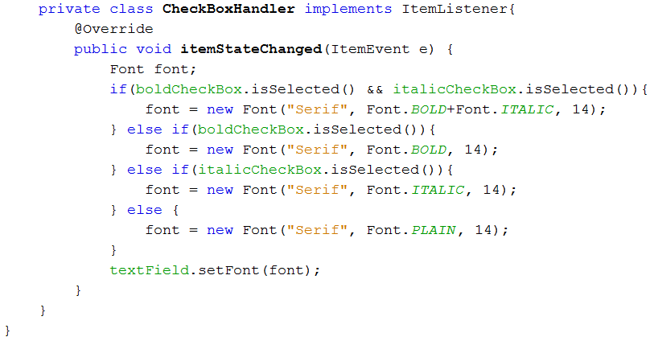
Swing API

Slide 34
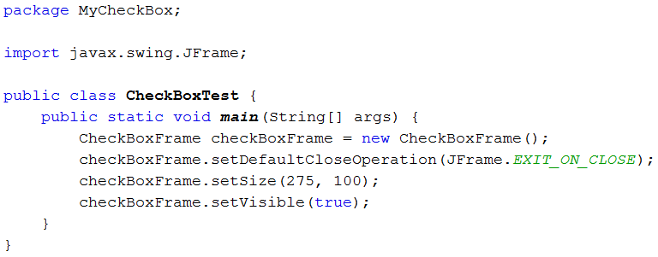
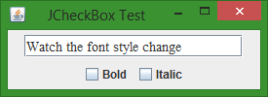
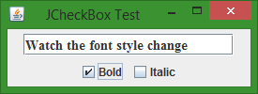
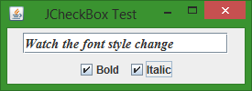
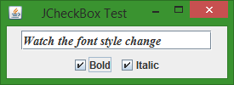
Swing API

Slide 35
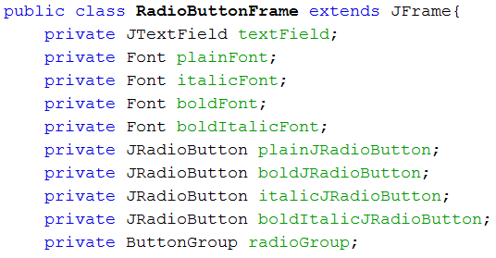
JRadioButton
Swing API

Slide 36
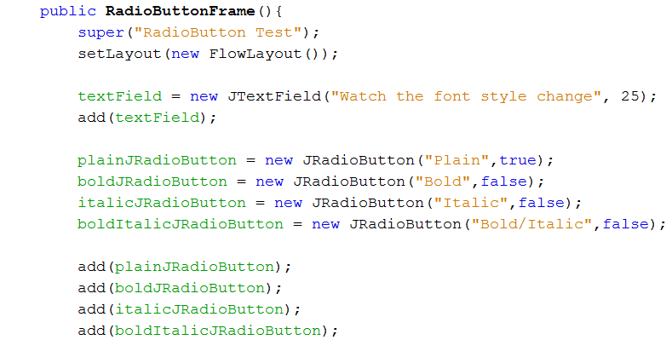
Swing API

Slide 37
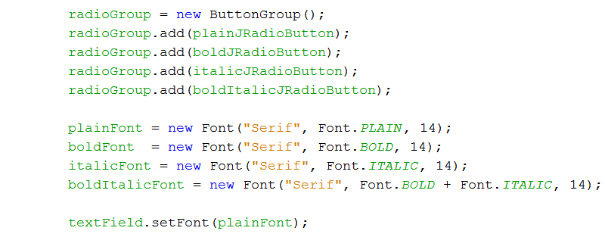
Swing API

Slide 38
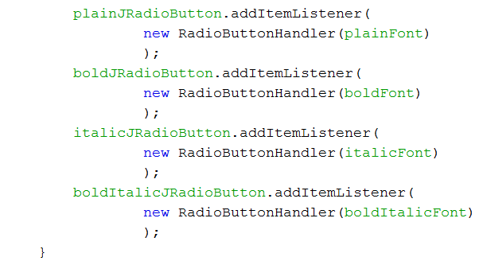
Swing API

Slide 39
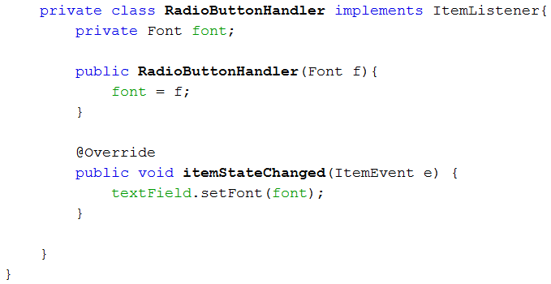
Swing API

Slide 40
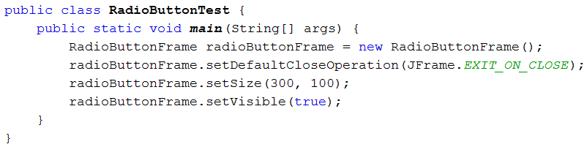
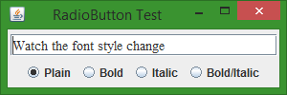
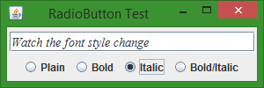
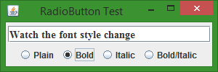
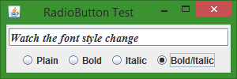
Swing API

Slide 41
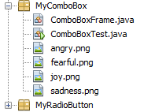
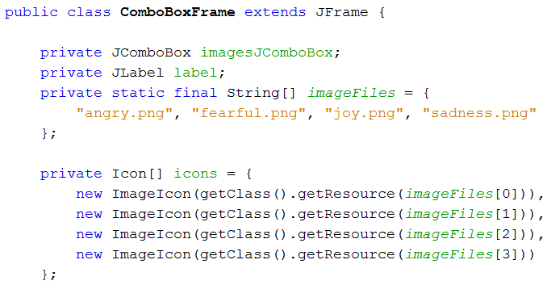
JComboBox
Swing API

Slide 42
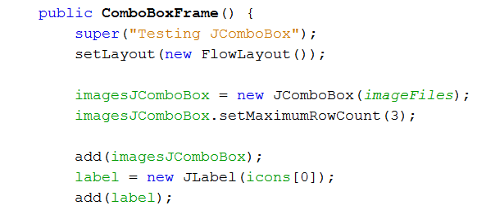
Swing API

Slide 43
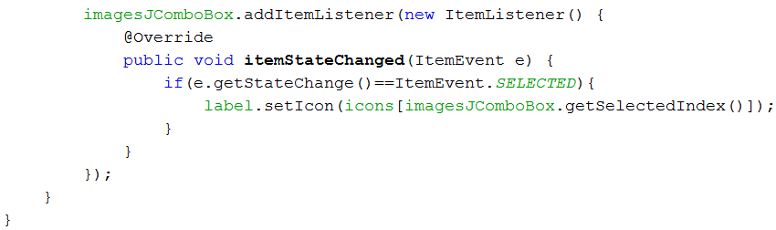
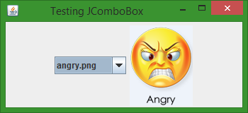
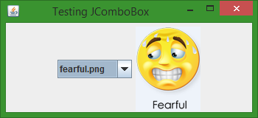
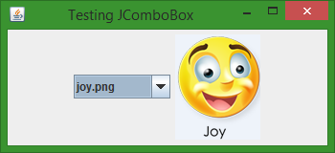
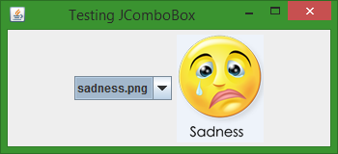
Swing API

Slide 44
JList
A list display a series of items from which the user may select one or more items. Lists are created with class JList, which directly extends class JComponent. Class JList supports single-selection lists (which allow only one item to be selected at a time) and multiple-selection list (which allow any number of items to be selected)
Swing API

Slide 45
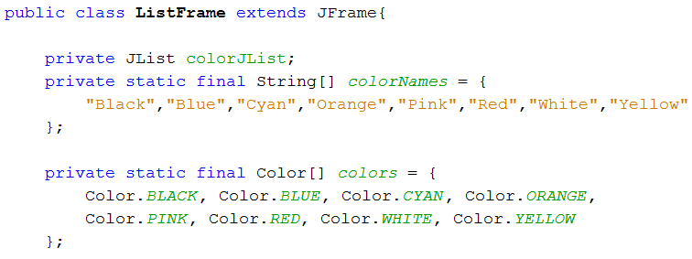
JList
Swing API

Slide 46

Swing API

Slide 47





Swing API

Slide 48

Jlist Multiple Selection
Swing API

Slide 49

Swing API

Slide 50




Swing API

Slide 51
Layout Managers
arrange GUI components in a container for presentation purposes
all layout managers implement the interface LayoutManager
Three ways to arrange components in a GUI
Absolute positioning
Layout Managers
Visual programming in an IDE
Swing API

Slide 52
Absolute Positioning
Provides the greatest level of control over a GUI’s appearance
Tedious part
Layout Managers
Simpler and faster
Lose some control over the size and the precise positioning of GUI components
Visual Programming in an IDE
Allows you to drag and drop GUI Components from a tool box
Codes are auto generated
Swing API

Slide 53
Layout Manager | Description
FlowLayout | Default for javax.swing.JPanel. Places components sequentially (left to right) in the order they were added. It’s also possible to specify the order of the components by using the Container method add, which take a Component and an integer index position as arguments.
BorderLayout | Default for Jframes (and other windows). Arranges the components into five areas. NORTH, SOUTH, EAST, WEST and CENTER.
GridLayout | Arranges the components into rows and columns.
Swing API

